Slide 1
Psoriasis

Slide 2
Introduction
Psoriasis is a common, chronic, relapsing, papulo-squamous dermatitis, characterized by an erythematous papules or plaques covered by silvery scales.
Psoriasis disrupts daily activities such as work attendance, interpersonal relationships, and recreational activities, thereby significantly impacting quality of life.
Psoriasis also places a large economic burden on society from healthcare costs to lost productivity.

Slide 3
Epidemiology
Worldwide the prevalence of psoriasis is widely variable ranging from 0.09% and 11.4%.
In Bangladesh the point prevalence of all types of psoriasis was 0.7%.
Plaque type was common variant (81%)
Age | Frequency
<18 | 17.8%
18-40 | 48.5%
<40 | 33.7%
Ref: Prevalence of psoriasis in Bangladesh: A community-based survey: Journal of Pakistan Association of Dermatologists. 2020; 30(1): 39-45.

Slide 4
Single site was involved in 42.1% and multiple sites in 57.9%cases.
Severity of the disease –
Mild (<10% BSA) in 57.1% cases
Moderate (10-30%) in 31.8%
Severe (>30%) in 12.1% cases
Ref: Prevalence of psoriasis in Bangladesh: A community-based survey: Journal of Pakistan Association of Dermatologists. 2020; 30(1): 39-45.

Slide 5
Symptoms of Psoriasis
Krueger G et al. Arch Dermatol 2001; 137: 280–4. 4

Slide 6
Types of Psoriasis
There are different types of psoriasis as follows-
Plaque psoriasis
Guttate psoriasis
Inverse psoriasis
Pustular psoriasis
Generalized pustular psoriasis
Nail psoriasis

Slide 7
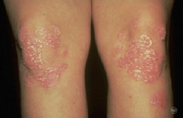
PLAQUE PSORIASIS
About 80% to 90% of people who have psoriasis develop this type1.
Features:
Patches of thick, raised skin called plaques
Scale (a dry, thin, and silvery-white coating) covers some plaques
Plaques of different sizes
Smaller plaques joining together to form larger plaques
Plaques usually form on the scalp, elbows, knees, or lower back, but they can develop anywhere on the skin.

Slide 8
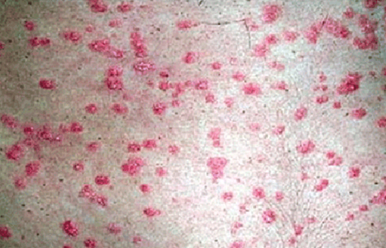
GUTTATE PSORIASIS
This type often develops in children, who get it after they’ve had an infection, such as strep throat. Guttate psoriasis tends to cause lots of small, scaly spots.
The bumps tend to cover much of the torso, legs, and arms. Sometimes, the bumps also develop on the face, scalp, and ears.
The bumps tend to be:
Small and scaly
Salmon-colored to pink
Temporary, clearing in a few weeks or months without treatment

Slide 9
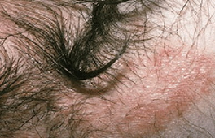
INVERSE PSORIASIS
It is also called intertriginous psoriasis or flexural psoriasis. This type of psoriasis develops in areas where skin touches skin, such as the armpits, genitals, and crease of the buttocks.
Features:
Smooth, red patches of skin that look raw
Little, if any, silvery-white coating
Sore or painful skin

Slide 10
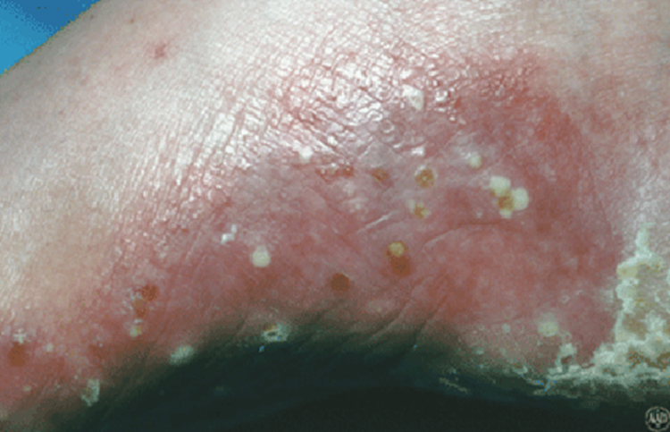
PUSTULAR PSORIASIS
This type of psoriasis causes pus-filled bumps that usually appear only on the feet and hands. While the pus-filled bumps may look like an infection, the skin is not infected. The bumps don’t contain bacteria or anything else that could cause an infection.
Features:
Red, swollen skin that is dotted with pus-filled bumps
Extremely sore or painful skin
Brown dots (and sometimes scale) appear as the pus-filled bumps dry

Slide 11
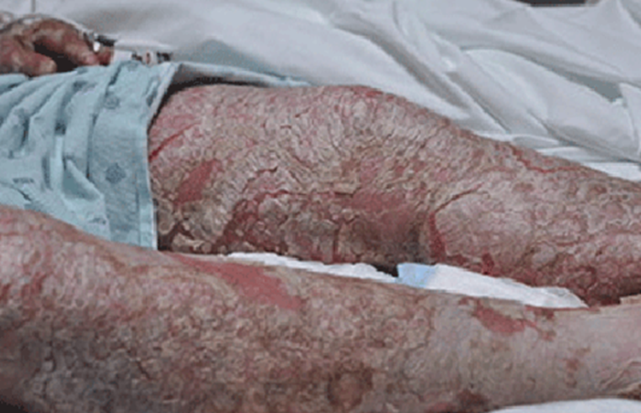
GENERALIZED PUSTULAR PSORIASIS
This is a rare, serious and life-threatening type of psoriasis which causes pus-filled bumps to develop on much of the skin. It is also called von Zumbusch psoriasis, a flare-up causes this sequence of events:
Skin on most of the body suddenly turns dry, red, and tender.
Within hours, pus-filled bumps cover most of the skin.
Often within a day, the pus-filled bumps break open and pools of pus leak onto the skin.
As the pus dries (usually within 24 to 48 hours), the skin dries out and peels (as shown in this picture).
When the dried skin peels off, a smooth, glazed surface is seen.
In a few days or weeks, a new crop of pus-filled bumps covers most of the skin, as the cycle repeats itself.
May be associated with fever, headache, muscle weakness, and other symptoms.

Slide 12
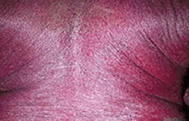
ERYTHRODERMIC PSORIASIS
This is also serious and life-threatening type of psoriasis which requires immediate medical care.
Features:
Skin on most of the body looks burnt
Chills, fever
Muscle weakness, a rapid pulse, and severe itch
Hypothermia can set in quickly.
Most people who develop erythrodermic psoriasis usually have another type of psoriasis. Before developing erythrodermic psoriasis, they often notice that their psoriasis is worsening or not improving with treatment.

Slide 13
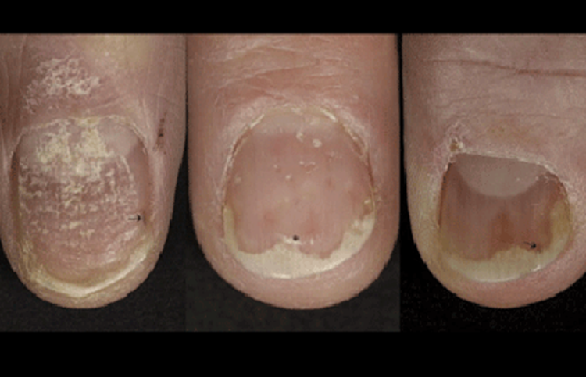
NAIL PSORIASIS
This can develop with any type of psoriasis. Signs include yellow-brown spots on the nails, pitted nails, crumbling nails, and nails separating from fingers or toes.

Slide 14
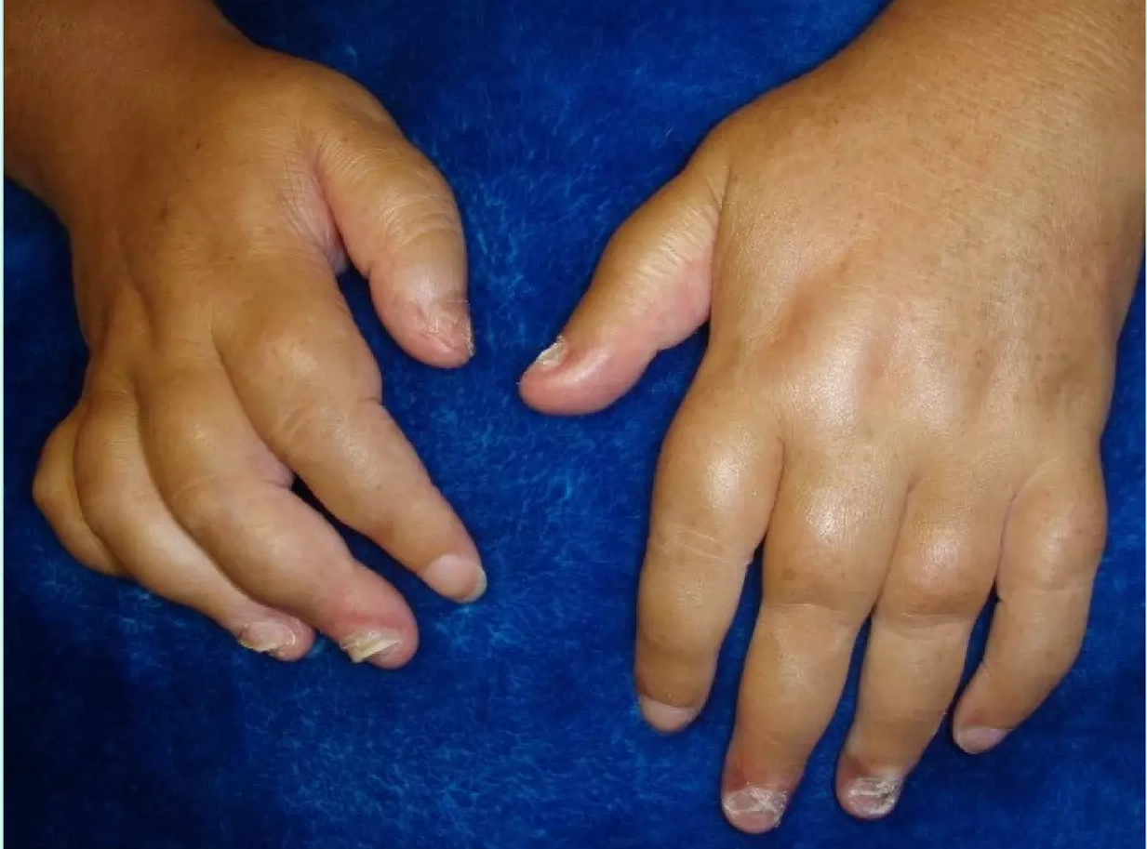
PSORIATIC ARTHRITIS
Approximately 5–20% have associated arthritis
Five major patterns of psoriatic arthritis:
Distal interphalangeal involvement
Symmetrical polyarthritis
Psoriatic spondylarthropathy
Arthritis mutilans
Oligoarticular, asymmetrical arthritis
Clinical expressions often overlap 30

Slide 15
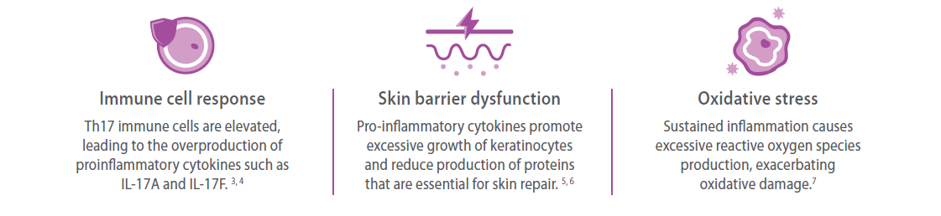
Pathophysiology
Exact etiopathogenesis of Psoriasis is unknown.
It is currently thought to result from genetically determined immune dysregulation resulting in -

Slide 16
COMMON TRIGGER FACTORS FOR PSORIASIS
Infections (e.g. streptococcal, viral)
Skin trauma (Koebner phenomenon)
Psychological stress
Drugs (e.g. lithium, beta blockers)
Sunburn
Metabolic factors (e.g. calcium deficiency)
Hormonal factors (e.g. pregnancy) 10

Slide 17
Diagnosis of Psoriasis
History taking-
Duration of symptoms
Family History
Treatment History
Physical examination
Sites of involvement
Types of psoriasis
Extention ( %BSA)

Slide 18
DIFFERENTIAL DIAGNOSIS
Tinea
Eczema
Superficial basal cell carcinoma and Bowen’s disease
Seborrhoeic dermatitis
Cutaneous T-cell lymphoma (mycosis fungoides)
Pityriasis rosea
Drug eruption
Secondary syphilis

Slide 19
Investigations
The appearance of a skin plaque leads to a psoriasis diagnosis, but symptoms can relate to other similar skin conditions. So, occasionally following investigations may be required-
Skin Biopsy
Blood Tests like ESR,CRP
Radiography to exclude psoriatic arthritis

Slide 20
Treatment
There is no known cure for Psoriasis.
The goals of management are:
To slow the rapid turnover of epidermis
To promote resolution of the psoriatic lesions
To control the natural cycles of the disease.
Advice to avoid any precipitating or aggravating factors .An assessment is made of lifestyle, because psoriasis is significantly affected by stress.

Slide 21
Treatment
The standard treatment modalities includes:
Topical therapy- Corticosteroids, coal tar, emollient creams, vitamin D derivatives (calcipotriene, calcitriol), vitamin A derivatives (tazarotene), anthralin.
Intralesional therapy -Triamcinolone acetonide
Systemic therapy- methotrexate, Cyclosporine, Hydroxyurea, Oral retinoids.
Photochemotherapy-Psoralen and Ultraviolet A (PUVA) Therapy, UVB therapy

Slide 22
Unmet needs
Although efficacious, topical corticosteroids have restrictions regarding-
Duration (Maximum 12 weeks)
Location
Extent of use-Body surface area (BSA) percentage (should be used in <20% BSA)
Tachyphylaxis (loss of effectiveness) and recurrence is often reported after extended use of corticosteroids or biologics.
Calcipotriene and tazarotene, have well documented adverse events, such as skin irritation, Qt prolongation.
No topicals with novel mechanisms of action had been approved by the Food and Drug Administration (FDA) for over 25 years, highlighting a need for efficacious topical therapies that address these limitations.

Slide 23
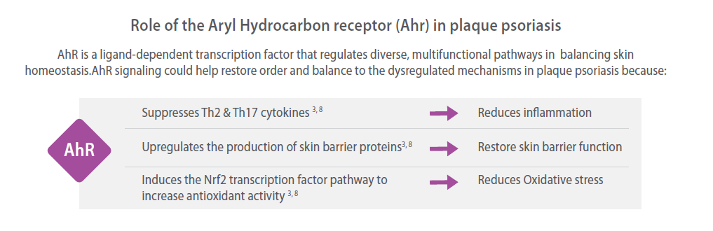
Until the arrival of Aryl hydrocarbon receptor Modulator- Tapinarof

Slide 24
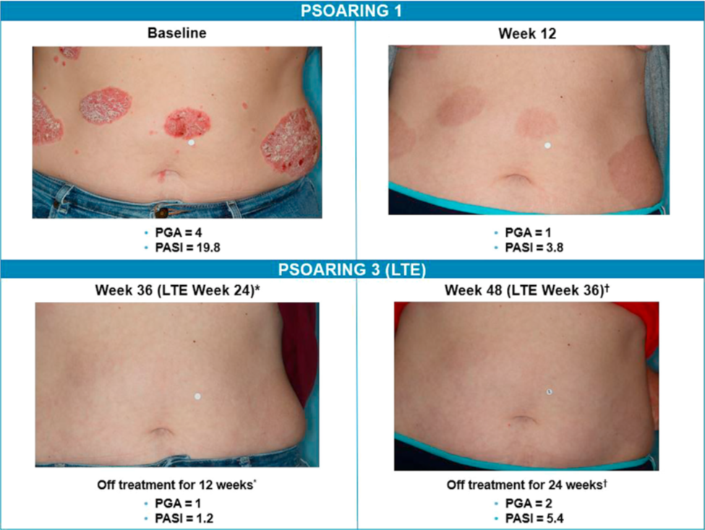
Efficacy
Two large, 12-week, phase III achieved the PGA* score of 0 or 1 and a decrease of 2–5 points at week 12 compared with vehicle.
6x the Efficacy vs Vehicle
TaClinical Response at Week 12 in PSOARING 1 and PSOARING 2 in Adults with Plaque Psoriasis (Intent-to-Treat; Multiple Imputation)
Clinical Response | PSOARING 1 |  | PSOARING 2
 | Tapinarof cream N=340 | Vehicle cream N=170 | Tapinarof cream N=343 | Vehicle cream N=172
PGA Treatment Success | 36% | 6% | 40% | 6%
Difference (95% CI) | 29% (22%, 36%) |  | 34% (27%, 41%)
Susan J. Keam,Tapinarof Cream 1%: First Approval, Drugs (2022) 82:1221–1228

Slide 25
Off treatment Effect
In an open-label, long-term extension study, the median time to PGA≥2 was 114 days (n=73).
Strober et al, J am acad dermatol volume 87, number 4

Slide 26
Tolerability
In clinical studies, Tapinarof cream showed a favorable and consistent safety profile and was well tolerated for up to 52 weeks.
Minimal systemic exposure to Tapinarof following topical application under conditions of maximal use (20-40% BSA involvement)
Most common adverse events were-
  Folliculitis (20%
  Nasopharyngitis (11%)
  Contact dermatitis(7%)
  Headache (4%)
  Pruritus (3%) and
  Influenza (2%)

Slide 27
Conclusion
Psoriasis is such a lifelong, disfiguring and crippling multisystem inflammatory disease mainly affecting skin and joints.
The point prevalence of all types of psoriasis was 0.7% where plaque type was common variant (81%).
57.9% cases have multiple sites involvement.
The most common topical agents used to treat psoriasis have been corticosteroids, vitamin D analogues and calcineurin inhibitors. While these agents show efficacy in psoriasis duration, BSA involvement and adverse effects limit their long-term use.

Slide 28
Conclusion
Tapinarof is a topical therapeutic aryl hydrocarbon receptor modulating agent that downregulates interleukin 17 and promotes skin barrier normalization, with antioxidant activity.
The efficacy and tolerability of Tapinarof in psoriasis clinical trials is attributed to its unique mechanism of action, representing an important potential advance in the development of topical medicine.
Minimum systemic side effects allow it to outcome the disadvantages of long term corticosteroid therapy like duration, BSA involvement, tachyphylaxis and systemic adverse effects.
Tapinarof 1% cream has shown to be effective and to have a favorable safety profile in the treatment of psoriatic patients, representing an alternative to the current therapeutic options, increasing our armamentarium in the topical treatment of psoriasis.

